Slide 1




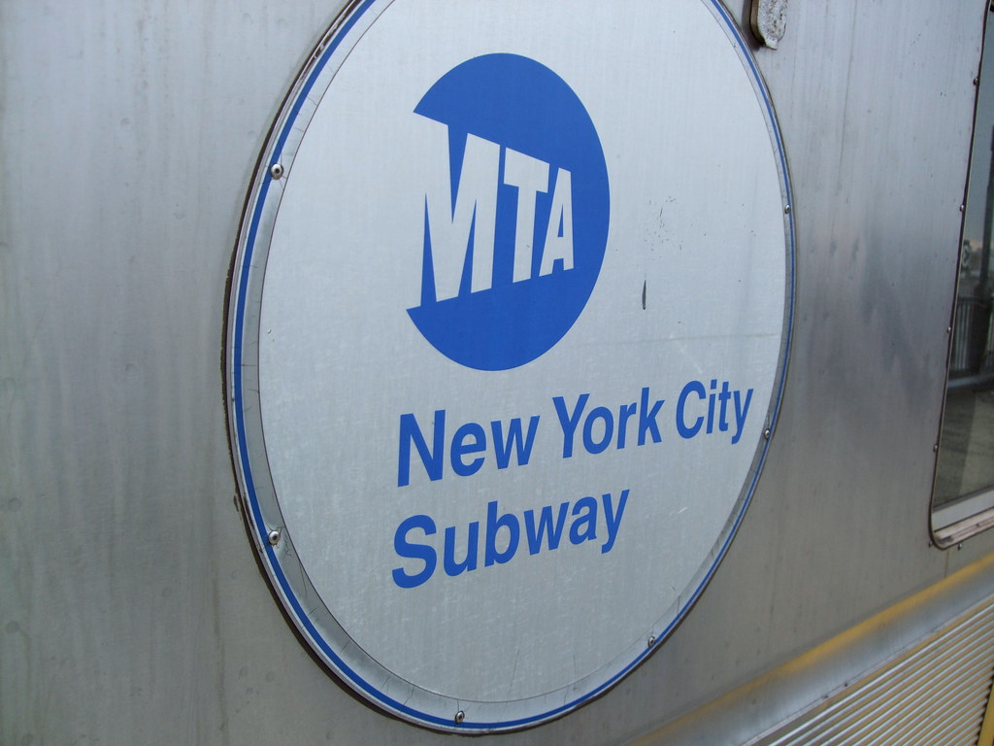
The Metropolitan Transportation Authority
MTA
PROJECT
Presented by:
Salma Said Mohi Eldein Hager Ahmed Abdelrasheed Shrouk Rabea Mohamed Ahmed Abdelrazik Muhammed Mo'men Hesham Mahmoud Abdelghafar Ahmed Abdelghafar

Slide 2

AGENDA
01
02
03
Overview
Goal
Data Processing Pipeline
04
05
06
Steps
Key Insights
Power BI

Slide 3

OVERVIEW
About The Project
Public transportation is the backbone of urban mobility, but what happens when a global crisis forces a dramatic shift in commuter behavior? This study uncovers how travel patterns transformed before and after the pandemic, revealing insights that could reshape the future of public transit.

Slide 4



The question "What happens when a global crisis forces a dramatic shift in commuter behavior?" led us to a deeper question...
Why does it matter to understand the answer?
Because knowing how people changed their travel habits helps us:
Improve future public transportation planning
Prepare for future crises
Design safer, more flexible transport systems

Slide 5



And this was...
The Goal of Our Project
Understanding the past helps us build a better future.

Slide 6

Data Processing Pipeline
CSV file were imported into Power BI to begin the analysis.
Dataset
Cleaning
Removed null values and duplicate entries.
Standardized datetime formats.
Transform data.
Created relationships between tables..
Data Modeling
DAX
Used DAX functions for calculated columns and measures
Summarized the most critical findings from the analysis, highlighting trends, patterns, and key takeaways for decision-making.
visuals
Reports
Designed interactive visuals to highlight trends. Added slicers for better filtering.
Designed an executive-level dashboard presenting core analytical insights through curated visualizations.
Dashboard

Slide 7

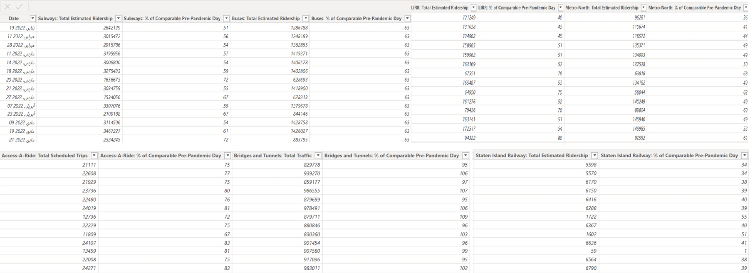
STEPS
01
Data Cleaning (Before Transformation):

Slide 8
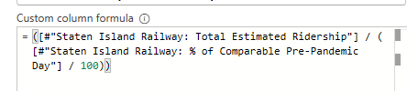
STEPS
01
Data Cleaning (Process):
Data was extracted for each transportation mode before COVID-19 by custom column.
An UNPIVOT operation was performed to was applied to merge pre- and post-COVID ridership data into a single column.
Three classifications were added:
Pre- and Post-COVID periods.
Seasonal classification.
Weekday vs. Weekend classification.

Slide 9


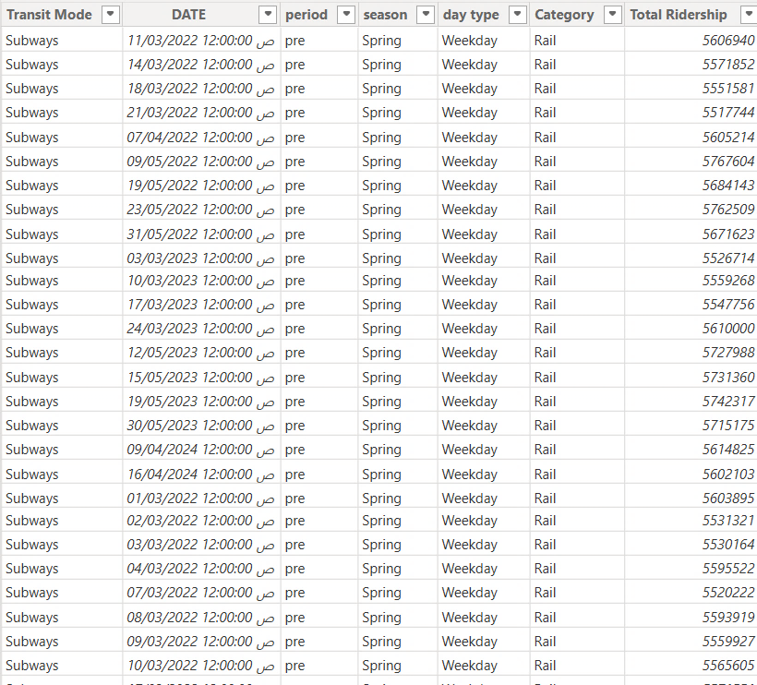
STEPS
01
Data Cleaning (After Transformation):

Slide 10
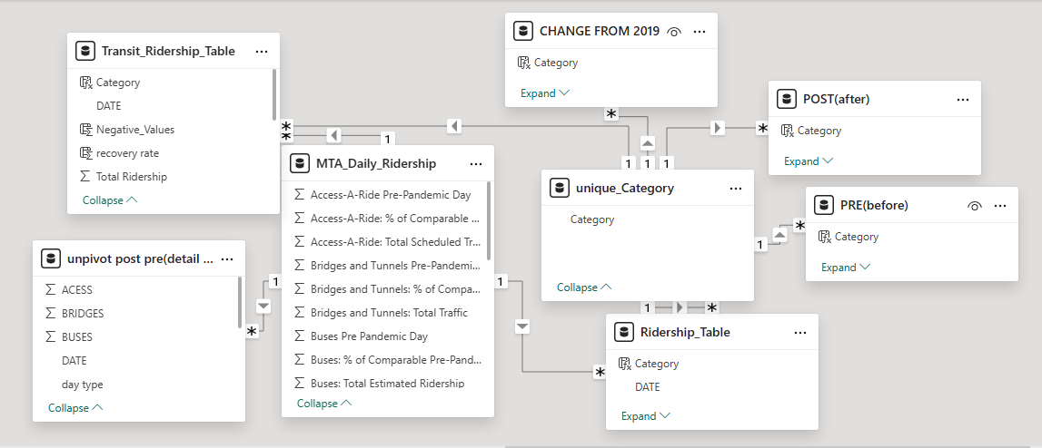

STEPS
02
DATA MODELING:

Slide 11
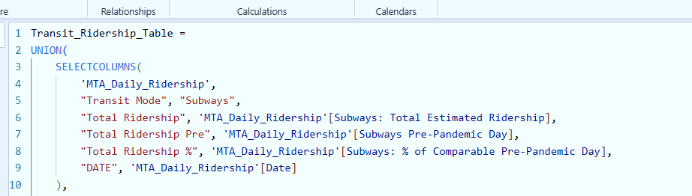
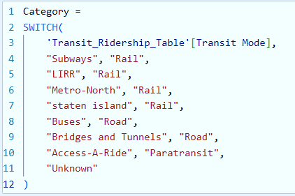
STEPS
02
DAX:
Note: The provided DAX formulas are samples, but they have been applied consistently across different categories and transportation modes:
The categorization DAX is used for all three categories.
The table creation DAX is applied to all seven transportation modes.
The comparison DAX Measures for pre- and post-2019 periods is also utilized across all seven transportation modes.
1
3
2

Slide 12

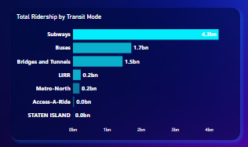
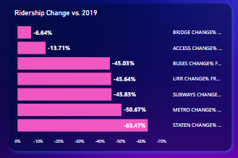
Key Insights & Visuals
From 2020 to 2024, subways accounted for the largest share of total transportation at 35.1%, despite experiencing a 45.83% decline compared to 2019, with a total ridership of 4.28 billion. Similarly, buses recorded 1.71 billion trips, marking a 45.03% decrease.
On the other hand, bridges and tunnels recorded a total ridership of 1.46 billion, but the percentage change compared to 2019 is 6.64%. Meanwhile, LIRR and Metro-North saw declines of 45.64% and 50.67%, respectively.
Staten Island Railway experienced the largest drop, falling 63.47% below 2019 levels. In contrast, Access-A-Ride declined by 13.71%, rather than showing an increase, reflecting a shift in demand for accessible transportation services.

Slide 13
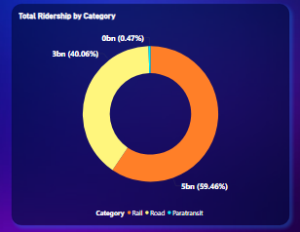
Key Insights & Visuals
The total ridership volume from 2020 to 2024, as of October, reached 8.43 billion, distributed across rail, road, and paratransit. Rail accounted for the largest share at 59.46% (5 billion), followed by road with 40.06% (3 billion), while paratransit contributed the remaining 0.47% (0.4 billion).
Understanding the distribution of ridership across these categories helps in optimizing resource allocation and improving transportation services. The dominance of rail highlights its central role in urban mobility, while road and paratransit services provide essential connectivity for different commuter needs.

Slide 14
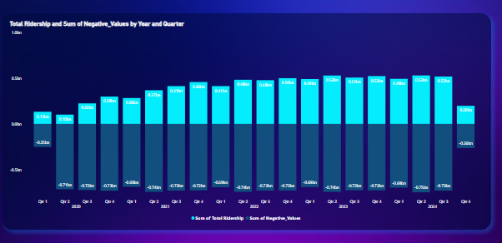
Key Insights & Visuals
The pandemic caused a sharp decline in transportation ridership, with 2020 experiencing the largest drop, especially in Q2 (-611 million) compared to 2019.
From 2021 to 2023, ridership gradually recovered, reducing the deficit to -200 million by 2023.
By Q4 2024, the gap further narrowed to -263 million below 2019 levels, reflecting a strong rebound as demand approached pre-pandemic levels.

Slide 15


Microsoft Power BI

Slide 16

conclusion
During the Pandemic :
Significant drop in ridership.
Imbalance in passenger distribution across transportation modes Despite the overall decrease in ridership, certain modes such as buses, subways, and bridges experienced noticeable overcrowding
After the Pandemic :
Gradual recovery in ridership However, numbers did not fully return to pre-pandemic levels.
Ongoing preference for the same modes of transportation.
which led to:
Resource exhaustion in these modes.
Underutilization of other transportation modes.
Difficulty in covering operational costs for the less-used modes due to decreased revenue.

Slide 17
solutions
Improving services of less-used transportation modes.
Surveys to understand passenger behavior.
Incentive-based pricing system (Dynamic Pricing & Rewards) Smart Nudging.
Passenger movement heatmaps.

Slide 18

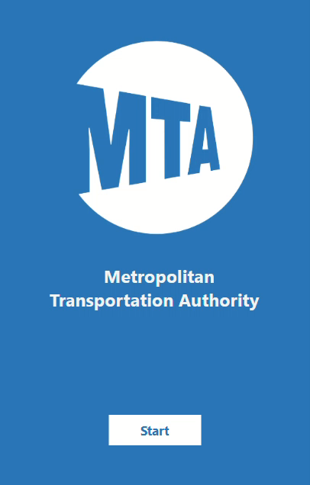
MTA App :

Slide 19

The Metropolitan Transportation Authority
Thanks' For Watching

